Slide 1
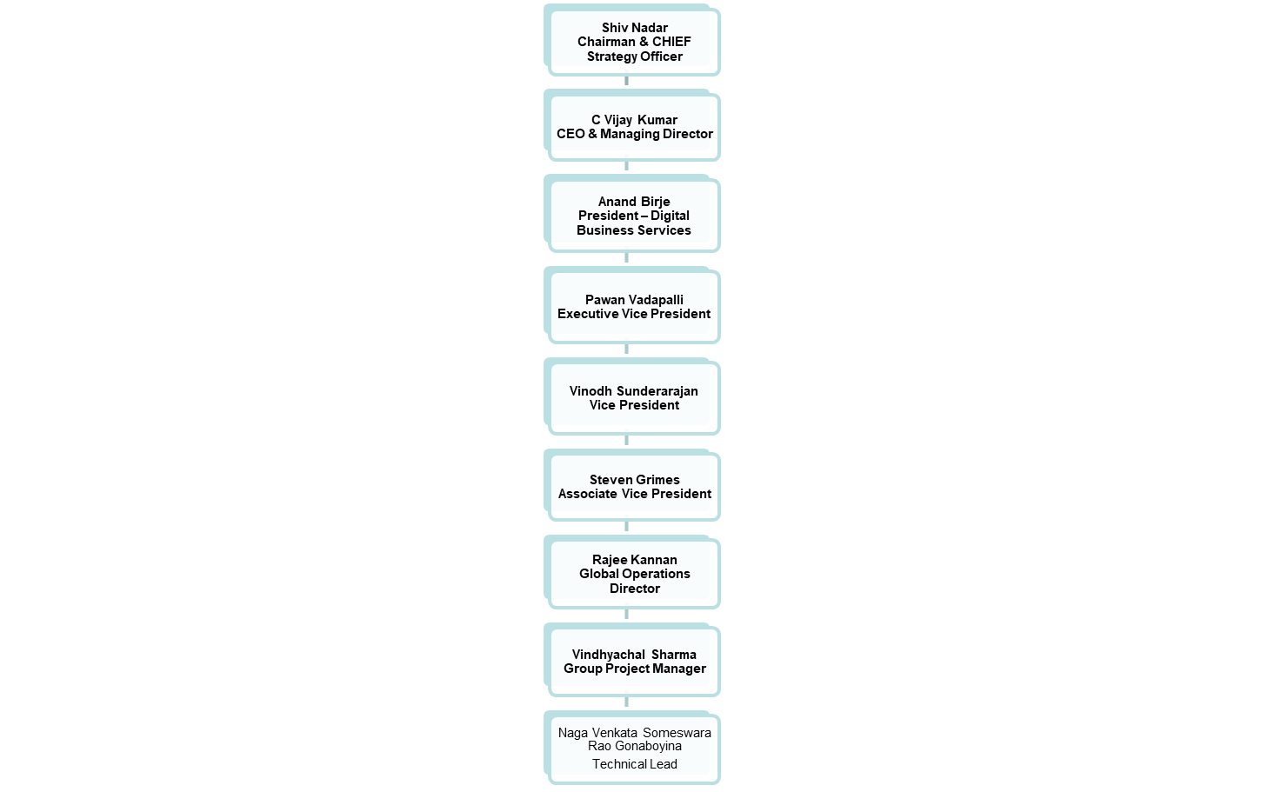
Beneficiary’s Supervisory Chain

